Slide 1
ERYTHROCYTE SEDIMENTATION RATE (ESR)

Slide 2
Relevance
ESR: The rate at which the red cells settle or sediment.
It is often required by a physician to rule out the presence of organic disease (aid in diagnosis), or to follow the progress of a disease.
ESR is generally done as part of complete blood tests.

Slide 3
Principle
In the circulating blood the red cells remain uniformly suspended in the plasma.
However, when a sample of anticoagulated blood, is allowed to stand in a narrow vertical tube, the RBCs being heavier (denser) than the plasma, settle or sediment gradually towards the bottom of the tube (rouleaux formation).

Slide 4
Sedimentation of red cells
The settling of red cells in a sample of anticoagulated blood occurs in 3 stages:
The first stage, the RBCs pile up (like a stack of coins), and form rouleaux that become heavier during the first 10-15 minutes.
Notes:
Thus, most of the settling of the red cells occurs in the first hour or so.

Slide 5
Sedimentation of red cells
The second stage, the rouleau being heavier sink to the bottom. This stage lasts for 40–45 minutes.
The third stage, there is packing of massed bunches of red cells at the bottom of the blood column. This stage lasts for about 10–12 minutes.
Notes:
Thus, most of the settling of the red cells occurs in the first hour or so.

Slide 6
Factors affecting ESR
Technical and mechanical factors
(The length of the tube, Diameter of the bore)
Physiological factors
(Age, Sex, High altitude, Pregnancy, Body temperature)
Viscosity of Blood
Nature of Anticoagulant Used

Slide 7
Clinical significance of ESR
As an indicator of bodily reaction to tissue injury and inflammation.
Value of ESR as a prognostic tool.

Slide 8
Normal values
Males : 3–9 mm 1st hour.
Females : 5–12 mm 1st hour.

Slide 9
Increased ESR
Pathological Increase in ESR is seen in:
All acute and chronic infections (localized or generalized), all anemias (except spherocytosis, sickle cell anemia, & pernicious anemia), bone diseases, connective tissue diseases, all malignant diseases, nephrosis, trauma, surgery.
Notes:
All causes (except anemias) tissue destruction which lead to increase fibrinogen or acute phase protein

Slide 10
Decreased ESR
Pathological decrease in ESR is seen in:
Polycythemia, anemias (spherocytosis, sickle cell anemia, & pernicious anemia), afibrinogenemia, severe allergic reactions.

Slide 11
Apparatus and materials
2 ml disposable syringe with needle, sterile cotton/gauze swabs moist with alcohol.
Sterile solution of 3.8 percent sodium citrate as the anticoagulant.
Westergren pipette (tube) and stand.

Slide 12
Westergren pipette
It is 300 mm long and has a bore diameter of 2.5 mm.
It is calibrated in mm from 0 to 200, from above downwards.
The ESR stand can accommodate up to 6 tubes at a time.

Slide 13
Westergren stand
For each pipette, there is a screw cap that slips over its top, and presses into a rubber pad at its lower end.
When the pipette is fixed in position, there is enough pressure of the screw cap to prevent leakage of blood from its lower end.

Slide 14
0
20
40
Westergren
pipette
60
80
120
140
160
180

Slide 15
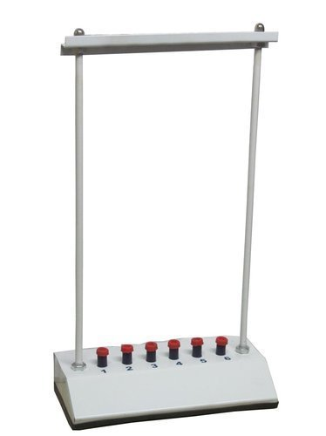
Westergren
stand

Slide 16
Procedure
Draw 2.0 ml of venous blood and transfer it into a vial containing 0.5 ml of 3.8% sodium citrate solution.
Mix the contents by inverting or swirling the vial.
Do not shake, as it will cause frothing.

Slide 17
Procedure
Fill the Westergren’s pipette with blood-citrate mixture by sucking, after placing the tip of your finger over the top of the pipette to control the flow of blood into and out of it, or with a rubber bulb. Bring the blood column to exact zero mark.
Notes:
(If there is a difference of 1–2 mm, it should be noted and taken into account before giving the final report at the end of one hour).

Slide 18
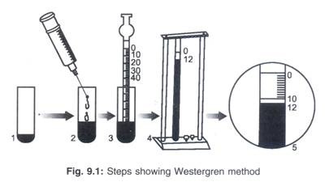
Procedure

Slide 19
Procedure
Keeping your finger over the pipette, transfer it to the Westergren stand by firmly pressing its lower end into the rubber cushion.
Now slip the upper end of the pipette under the screw cap.
Confirm that there is no leakage of blood and that the pipette will remain vertical.

Slide 20
Procedure
Leave the pipette undisturbed for one hour, at the end of which read the mm of clear plasma above the red cells.
Express your results as: ………………mm 1st hour.

Slide 21
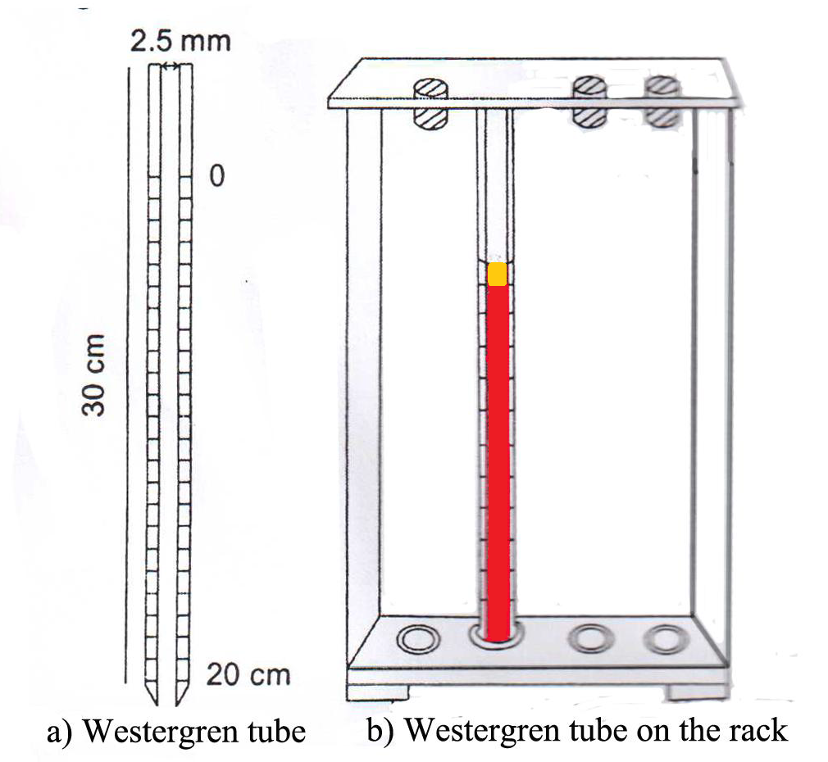
Observations and result

Slide 22
Sources of error
These include:
Tilting of the tube and high temperature lead to high values.
Low temperature gives false low values.
Hemolysed blood may obscure the sharp line separating red cells and the plasma.

Slide 23
PRECAUTIONS
The test should preferably be done within 2–3 hours of collecting the blood sample, and at a room temperature of 20–35°C.
The hematocrit should be checked and correction factor applied in cases of anemia.

Slide 24
PRECAUTIONS
Clotted or hemolysed blood must be discarded.
The Westergren pipette should not be disturbed from the vertical position for the duration of the test.

